Slide 1
SE Project
CS331
Group No. : G-8
1. Shivendra Giri (1901189)
2. Priyam Das (1901146)
3. Rishav Adarsh (1901159)

Slide 2
Testing Reports

Slide 3
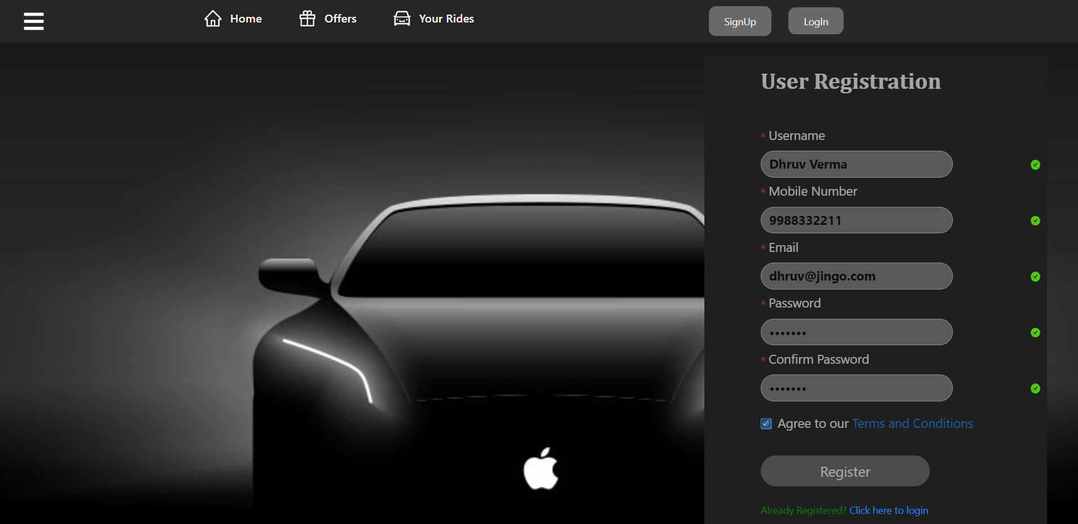
SignUp Testing :
(i) For Valid Inputs :
INPUT :
When user fill up the registration
form as per the required
constraints.

Slide 4
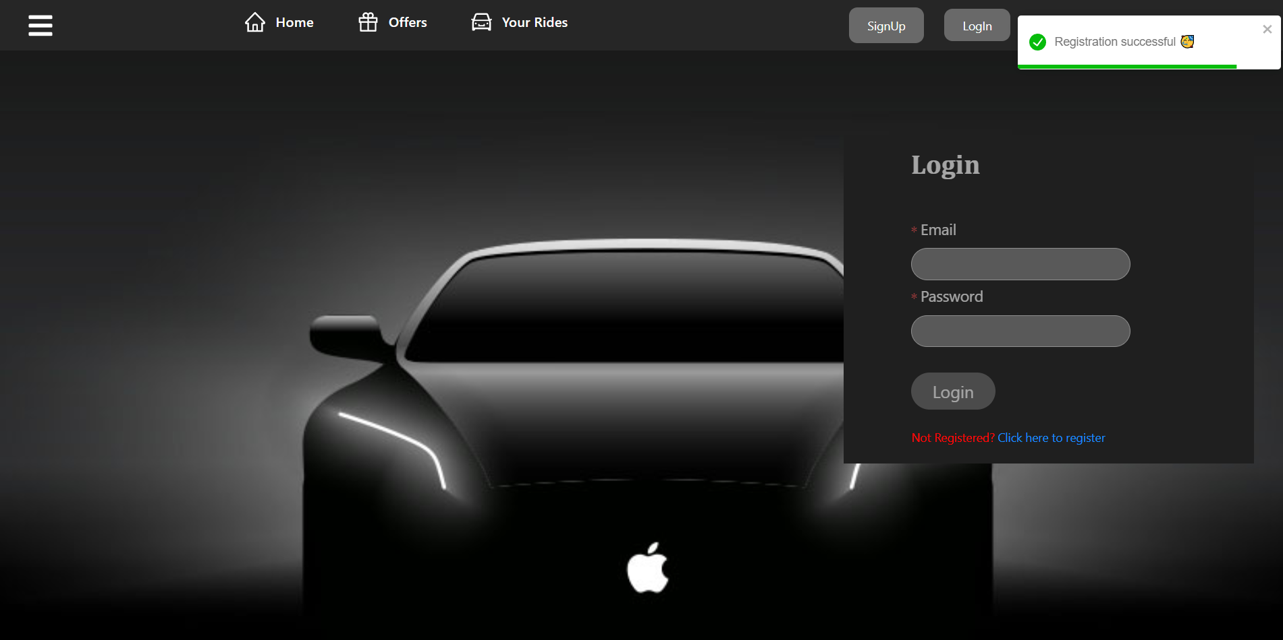
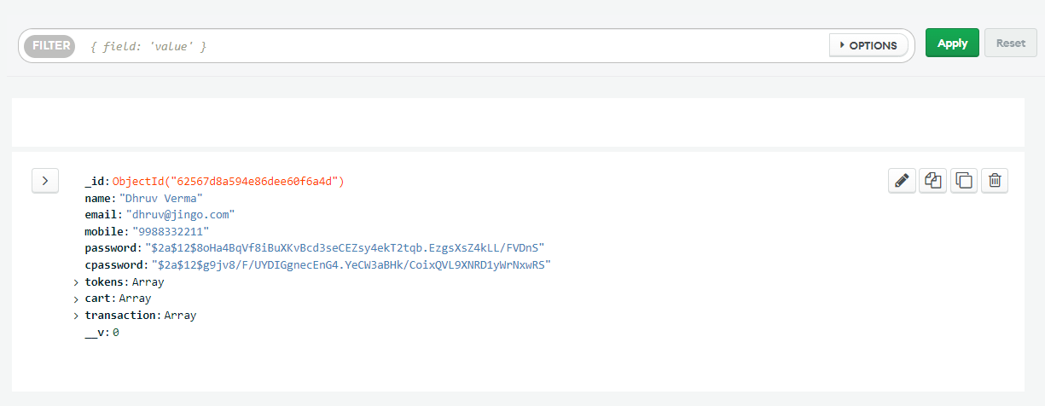
OUTPUT :
User will be shown a success
message depicting a positive
response on submission and will
be navigated to the login page .
After the successful submission
the data will be stored on the
database .

Slide 5
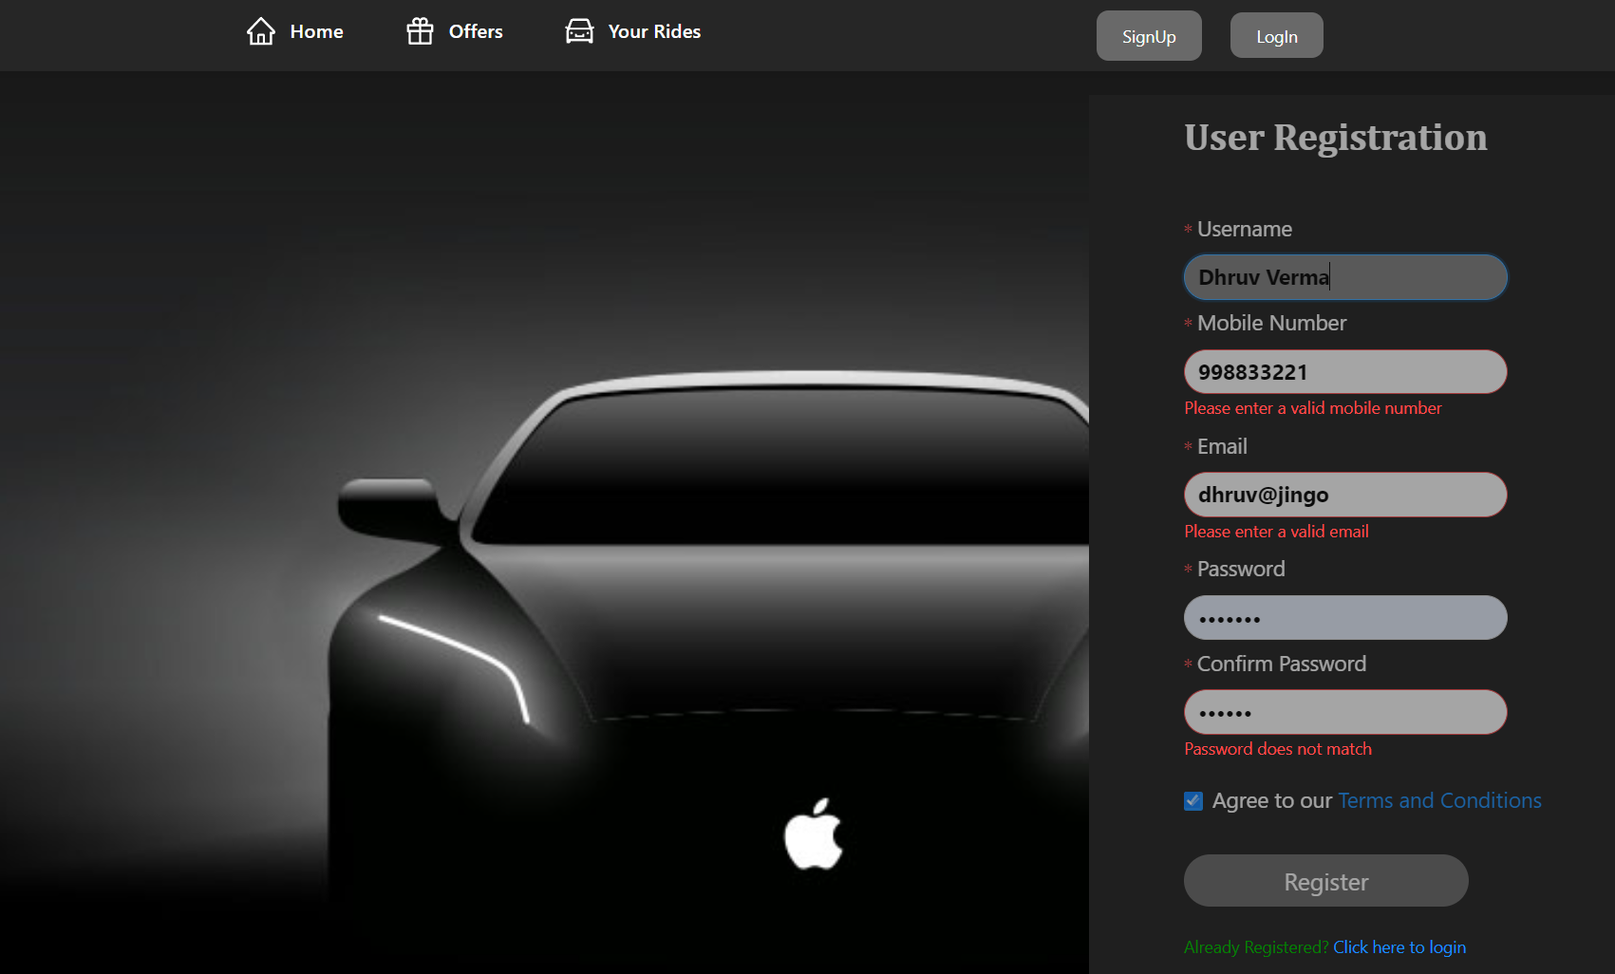
(i) For Invalid Inputs :
INPUT :
When user fill up the registration
form leaving out some of the
fields or filling it out not
following the constraints.

Slide 6
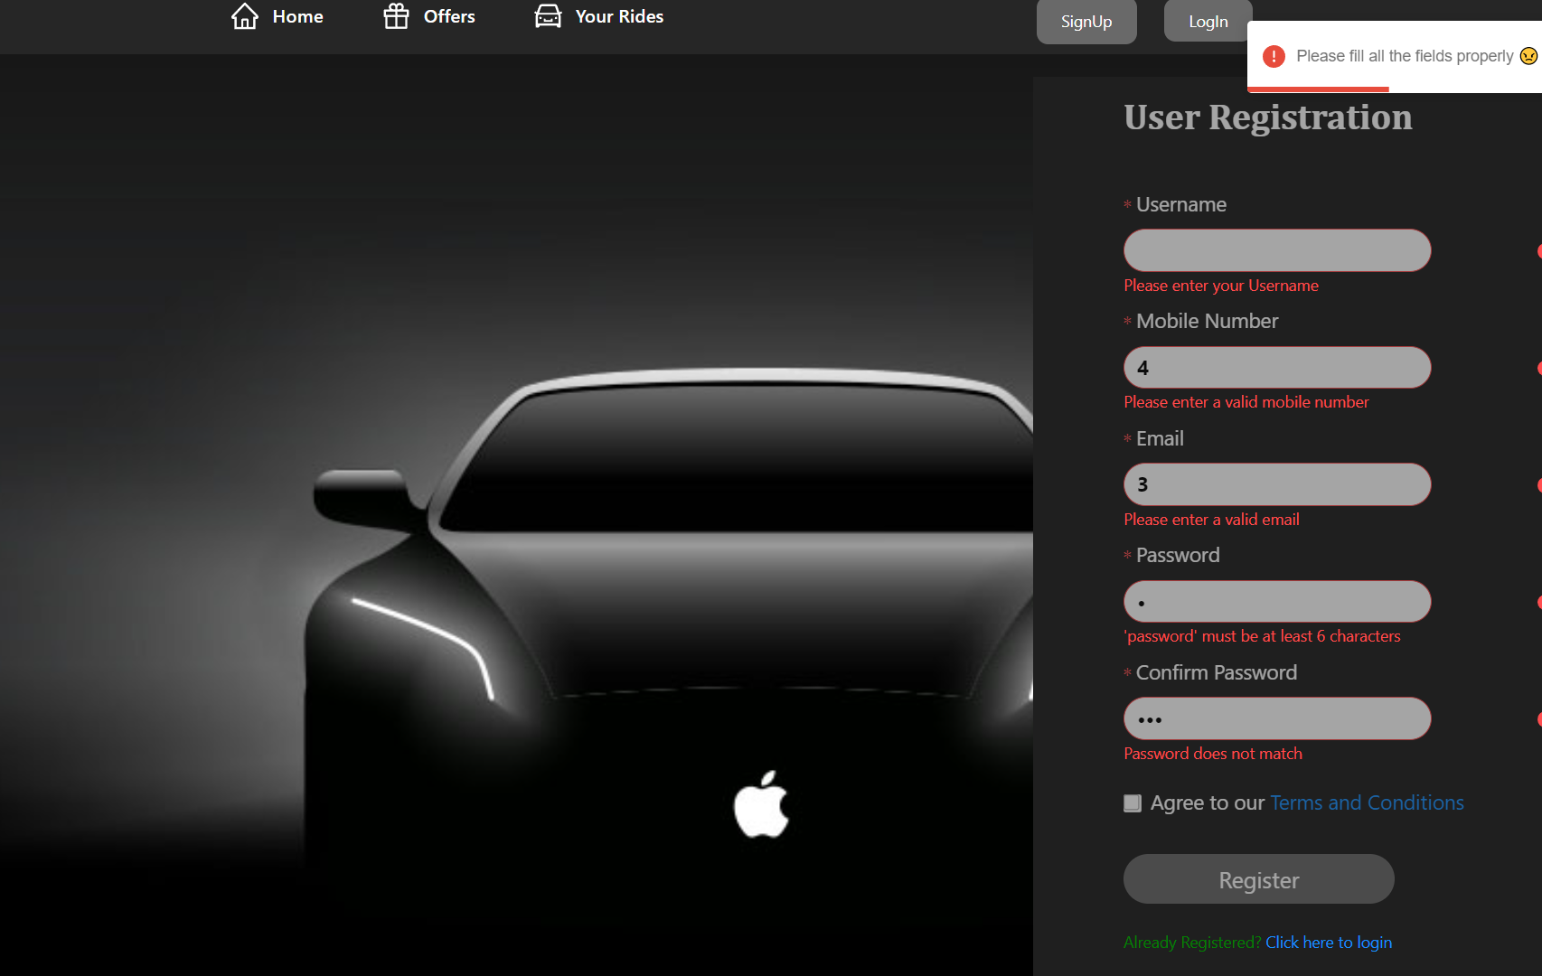
OUTPUT :
User will be shown an error
message depicting a negative
response on submission.
In this case ,our frontend server won’t allow this data
to fetch the backend server and hence no data will be stored
on the database this time .

Slide 7
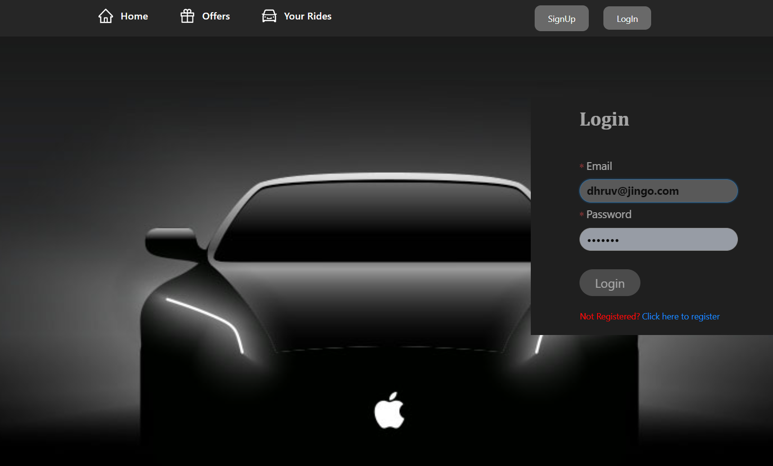
LogIn Testing :
(i) For Valid Inputs :
INPUT :
When user fill up the login
credentials correctly.

Slide 8
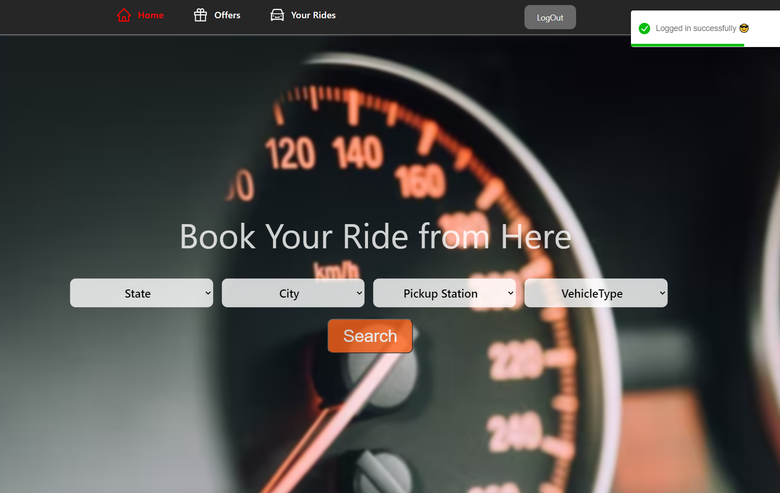
OUTPUT :
Post submission the input
credentials will be matched
with that of on the database and
then the user will be shown a success
message depicting a positive
response and will be navigated
to the home page .

Slide 9
(i) For Invalid Inputs :
INPUT :
When the user fill up the
credentials incorrectly.

Slide 10
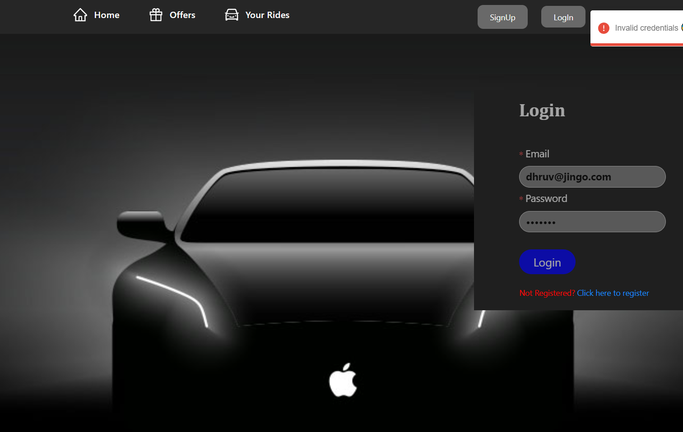
OUTPUT :
Post submission the input
credentials will be matched
with that of on the database and
then the user will be shown a error
message depicting a negative
response and user will be recommended
to fill the credentials again .

Slide 11
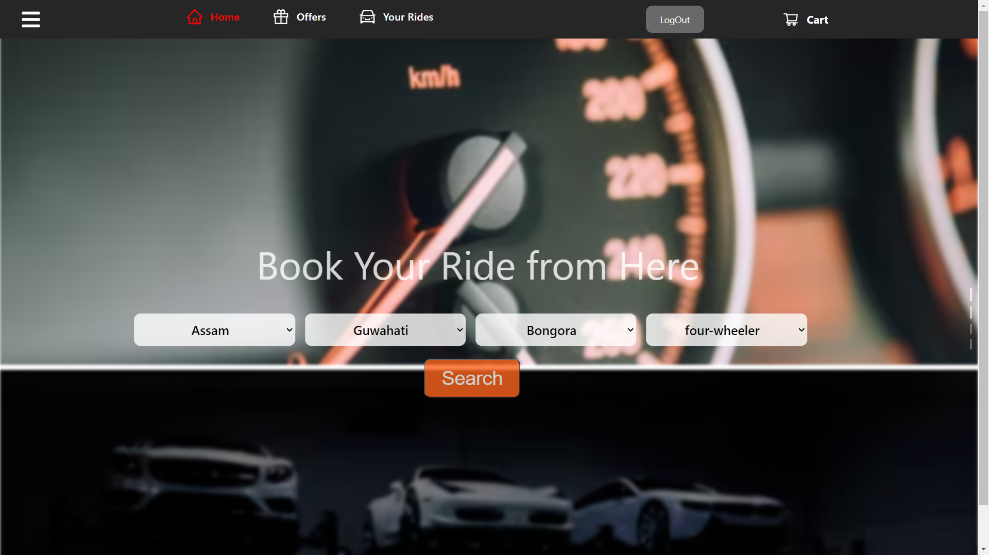
Search Testing :
(i) For Valid Inputs :
INPUT :
When user fill up the all the
the given fields in the search
bar properly.

Slide 12
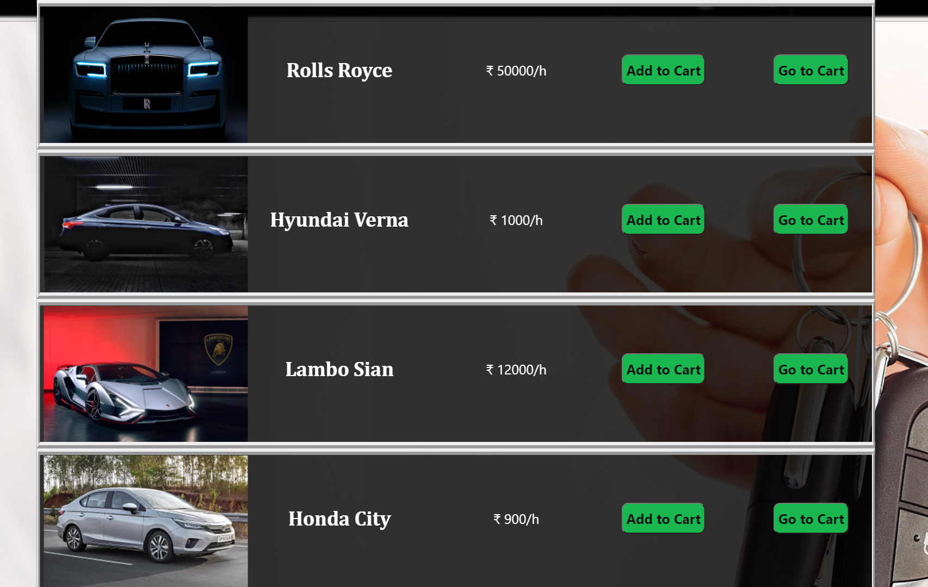
OUTPUT :
Post submission the input
search details will be matched
with that of on the database and
then the user will be shown the
requested list of vehicles and from
here only the user can select
any vehicle of his/her choice by clicking on addToCart button and
can finally visit the cart by clicking the goToCart button .

Slide 13
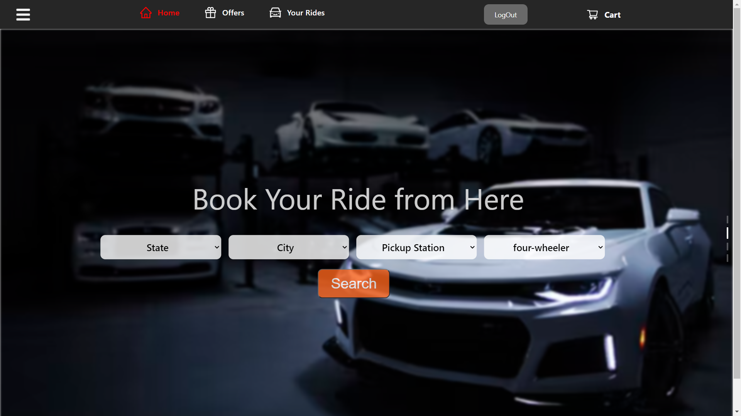
(i) For Invalid Inputs :
INPUT :
When the user left out
filling some of the fields .

Slide 14
OUTPUT :
Post submission the null input
won’t get matched with any items
on the database and hence
the user will be displayed an empty
list .

Slide 15
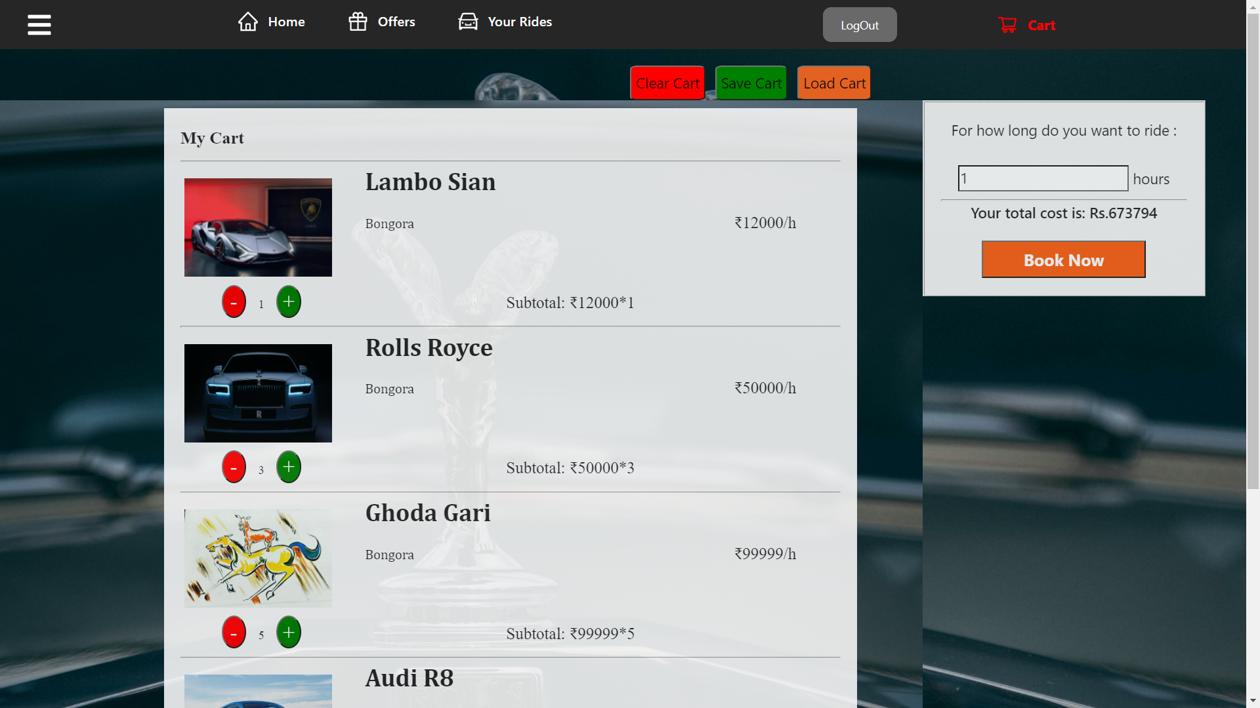
Cart Testing :
INPUT :
After the user is done with his/her
manipulation of the cart i.e. the item
and its quantity and selecting for
number of hours he wanted to book
,he will click on the BookNow button .

Slide 16
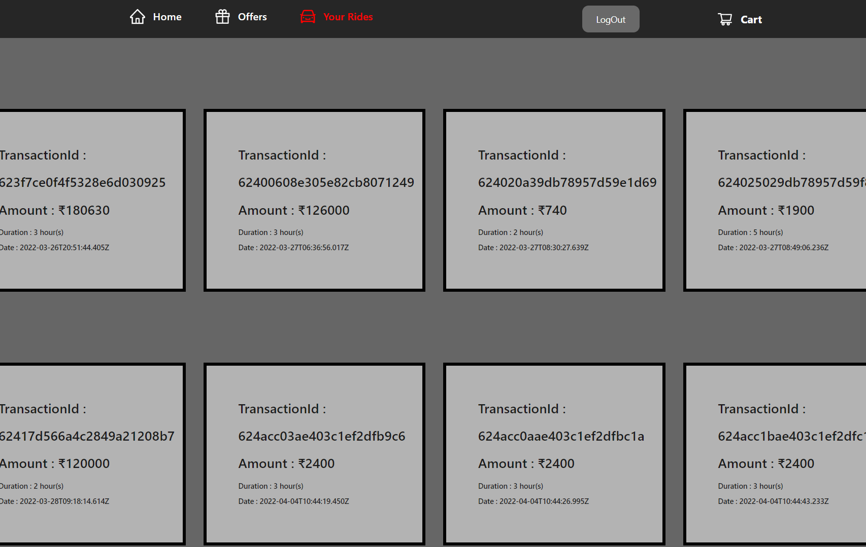
OUTPUT :
Post submission and successful
payment the user will get directed
to the YourRides/transaction
page where he/she will be able to
fetch all his/her past transaction
details .

